Slide 1




WEB PAGES DESIGN
Introduction to JavaScript: Functions,
DOM, Forms, and Event Handlers
Part (1)
Lecturer: Dr. Atheer Akram AbdulRazzaq
Lecture 10.
Class 2.
Time: 10:30 - 12:30
Department: Businesses Information Technology (BIT)

Slide 2
Outline
Outline
History of JavaScript
Buttons
Functions
Variables
Identifiers
Assignment Statements and Objects
Document Object Model
Forms and How They’re Processed: Client- Side Versus Server-Side
form Element
Controls
Summary

Slide 3
Outline
History of JavaScript
In 1995, the dominant browser manufacturer was Netscape, and one of its employees, Brendan Eich, thought that it would be useful to add dynamic functionality to web pages. So he designed the JavaScript programming language, which adds dynamic functionality to web pages when used in conjunction with HTML.
For example, JavaScript provides the ability to update a web page’s content when an event occurs, such as when a user clicks a button. It also provides the ability to retrieve a user’s input and process that input.
Note. the JavaScript is not all that similar to Java. Actually, C++ and other popular programming languages are closer to Java than JavaScript is.
In 1996, Netscape submitted JavaScript to the Ecma International standards organization to promote JavaScript’s influence on all browsers (not just Netscape’s browser).
Ecma International used JavaScript as the basis for creating the ECMAScript standard. As hoped, ECMAScript now serves as standard for the interactive programming languages embedded in all of today’s popular browsers.
In 1998, Netscape formed the Mozilla free-software community, which eventually implemented Firefox, one of today’s premier browsers. Brendan Eich moved to Mozilla, where he and others have continued to update JavaScript over the years, following the ECMAScript standard as set forth by Ecma International.

Slide 4
Outline
History of JavaScript (continue…)
Internet Explorer and Edge browsers, Microsoft uses JScript. For their Chrome browser, Google uses the V8 JavaScript Engine. Fortunately, all the browser manufacturers attempt to follow the ECMAScript.
As with almost everyone in the web-programming community, we refer to our code as JavaScript, even though JavaScript is just one of several ECMAScript implementations (JavaScript is the implementation used in Mozilla’s Firefox).
Hello World Web Page
Our first JavaScript “program” in example 1., Hello web page, which displays “Hello, world!” when the user clicks the button.
Now take a look at the Hello web page’s source code in example1., we can see that there’s not much JavaScript—it’s just the code in the script container and the code that follows the onclick attribute.
Example 1.
<!DOCTYPE html>
<html lang="en">
<head>
<meta charset="utf-8">
<meta name="author" content=“AAA">
<title>Hello</title>

Slide 5
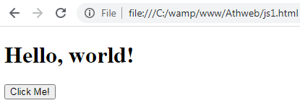
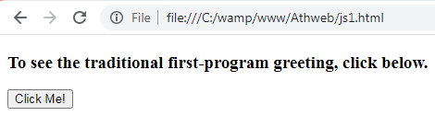
Outline
Hello World Web Page (continue…)
Example 1., (continue…)
<script>
function displayHello() {
var msg;
msg = document.getElementById("message");
msg.outerHTML = "<h1>Hello, world!</h1>";
}
</script>
</head>
<body>
<h3 id="message">
To see the traditional first-program greeting, click below.
</h3>
<input type="button" value="Click Me!" onclick="displayHello(); ">
</body>
</html>
Output:
JavaScript code

Slide 6
Outline
Buttons
There are different types of buttons, each with its own syntax. To keep things simple, we’ll start with just one type of button, and here’s its syntax:
<input type="button"
value="button-label"
onclick="click-event-handler">
Note that the code is a void element that uses the input tag. As its name suggests, the input tag implements elements that handle user input. We’re showing input element’s most common attributes—type, value, and onclick.
The input element is used for different types of user input, and its type attribute specifies which type of user input.
More formally, the type attribute specifies the type of control that’s being implemented, where a control is a user input entity such as a button, text control, or checkbox.
In the Hello web page source code, note that the type attribute gets the value button, which tells the browser to display a button. If you don’t provide a type attribute, the browser will display a text control, because that’s the default type of control for the input element. A text control is a box that a user can enter text into, and this is what a (filled-in) text control looks like:
First Name: Ahmed

Slide 7
Outline
Buttons (continue…)
The input element’s value attribute specifies the button’s label. If you don’t provide a value attribute, the button will have no label. If you want a button with no label, rather than just omitting the value attribute, we recommend that you specify value="".
The input element’s onclick attribute specifies the JavaScript instructions that the JavaScript engine executes when the user clicks the button. What’s a JavaScript engine, you ask? A JavaScript engine is the part of the browser software that runs a web page’s JavaScript.
what’s supposed to happen when the user clicks the button. Clicking the button is considered to be an event, so the onclick attribute’s JavaScript code is known as an event handler.
Note that the onclick attribute’s value is simply displayHello();. That calls the displayHello function, which is defined in the web page’s script block.
Functions
A JavaScript function might receive arguments, will perform a calculation, and might return an answer. Here’s the syntax for calling a function:
function-name(zero-or-more-arguments-separated-by-commas);

Slide 8
Outline
Functions (continue…)
The Hello web page button has an onclick attribute with a value of displayHello();. That’s a JavaScript function call, and its syntax matches the preceding syntax.
Note the parentheses are empty because there’s no need to pass any argument values to the displayHello function. If there were arguments, they would need to be separated by commas, and proper style suggests that you insert a space after each comma.
Here’s the syntax for a function definition:
function function-name(zero-or-more-parameters-separated-by-commas) {
statement-1;
statement-2;
…
last-statement;
}
And here’s the displayHello function definition from the Hello web page:
function displayHello()
{
var msg;
msg = document.getElementById("message");
msg.outerHTML = "<h1>Hello, world!</h1>";
}
function heading
function body

Slide 9
Outline
Functions (continue…)
The parentheses in the function heading are empty because the function call’s parentheses are empty (the function call was displayHello();).
If there are arguments in the function call, then you’ll normally have the same number of parameters in the function heading—one parameter to receive each argument’s value.
The function definitions should be placed (1) in a script container in the web page’s head container or (2) in an external JavaScript file. We’ll want to use an external JavaScript file if we have lots of JavaScript code.
We can see three lines in the function’s body in the previous code fragment, . Each line is a JavaScript statement, where a statement performs a task.
Note the semicolons at the end of all three statements. Semicolons are required at the end of a JavaScript statement only if the JavaScript statement is followed by another JavaScript statement, so it would have been legal to omit the semicolon after the last statement.
Suppose there’s no semicolon at the end of the last statement and someone later adds a new statement after the last statement. If they forget to insert a semicolon between the two statements, that creates a bug. Also if you don’t do it, the JavaScript engine does it for you behind the scenes, and that slows things down slightly.

Slide 10
Outline
Variables
Here’s the function’s first statement:
var msg;
The msg thing is a variable. You should already be familiar with variables in algebra. You can think of a variable as a box that holds a value. In this case, the msg variable will hold a string that forms a message. Before you use a variable in JavaScript code, you should use var to declare the variable in a declaration statement. For example:
var name;
var careerGoals;
Words that are part of the JavaScript language are known as keywords. The word var is a keyword. On the other hand, name and careerGoals are not keywords because they are specific to a particular web page’s code and not to the JavaScript language in general.
We showed the displayHello function and in that function, besides var, can you identify another keyword? The function heading uses the word function and Function is a keyword.
So you cannot use “function” as the name of a variable. Those keywords are “reserved” for the JavaScript language, and they are known as reserved words.
When you declare a variable, you specify the type of values that the variable will be allowed to hold—numbers, strings, and so on. However, with JavaScript, you do not specify the variable’s type as part of the declaration.

Slide 11
Outline
Variables (continue…)
The variable’s type is determined dynamically by the type of the value that’s assigned into the variable. For example:
name = "Mia Hamm";
careerGoals = 158;
"Mia Hamm“, is a string, since a string consists of zero or more characters surrounded by a pair of double quotes (") or a pair of single quotes ('). 158 , is a number, since a number consists of digits with an optional decimal point.
JavaScript is known as a loosely typed language, or a dynamically typed language, which means that you do not declare a variable’s data type explicitly, and you can assign different types of values into a variable at different times during the execution of a program.
For example, it would be legal to assign a string to name and then later assign a number to name. But proper coding conventions dictate that you don’t do that, because it can lead to code that’s difficult to understand.
Identifiers
In the Hello web page, displayHello was the identifier for the function name, and msg was the identifier for a variable.
In naming your variables and functions, the JavaScript engine requires that you follow certain rules. Identifiers must consist entirely of letters, digits, dollar signs ($), and/or underscore (_) characters.

Slide 12
Outline
Identifiers (continue…)
Coding-convention rules are narrower than the preceding rules. Coding conventions suggest that you use letters and digits only, not dollar signs or underscores. They also suggest that all letters should be lowercase except the first letter in the second word, third word, and so on.
Notice that the identifiers’ words are descriptive. Coding conventions suggest that you use descriptive words for your identifiers. Beginning programmers have a tendency to use names like x, y, and num.
Those are bad variable names. However, if you have a situation in which you’re supposed to read in a number and the number doesn’t represent anything special, then x or num is OK.
Assignment Statements and Objects
We need to talk about assignment statements and objects. Once again, here’s the Hello web page’s displayHello function:
function displayHello() {
var msg;
msg = document.getElementById("message");
msg.outerHTML = "<h1>Hello, world!</h1>";
}
variable declaration
assignment statements

Slide 13
Assignment Statements and Objects (continue…)
Outline
In function’s body, first statement is a variable declaration for msg variable.
After you declare a variable, you’ll want to use it, and the first step in using a variable is to put a value inside it.
As you can see in the preceding example, the function body’s second and third statements are assignment statements. The assignment operator (=) assigns the value at the right into a variable at the left.
So in first assignment statement, the document.getElementById ("message") thing gets assigned into the msg variable. In the second assignment statement, "<h1>Hello, world!</h1>" thing gets assigned into msg.outerHTML variable.
To understand the syntax requires an understanding of objects. An object is a software entity that represents something tangible. The fact that it’s software means that it can be manipulated with JavaScript code, which provides you, the programmer, with great power!.
All of the elements in a web page are represented as objects. When a browser loads the Hello web page, the browser software generates objects for the head element, the body element, the h3 element, and so on.
There’s also an object associated with the entire web page, and that object’s name is document.
A property is an attribute of an object. A behavior is a task that the object can perform.

Slide 14
Assignment Statements and Objects (continue…)
Outline
Most web pages these days have a value of HTML5 for the document object’s type property. The type property’s value comes from the doctype instruction, which should appear at the top of every web page. Here’s the Hello web page’s doctype instruction:
<!DOCTYPE html>
The html value indicates that the document object’s type is HTML5. To access an object’s property, you specify the object name, a dot, and then the property name.
So to access the current web page’s document type, use document for the object name, . for dot, and doctype for the property.
Here’s the JavaScript code:
document.doctype
Object is not only a set of properties, but also a set of behaviors. One of the document object’s behaviors is its ability to retrieve an element using the element’s id value.
In JavaScript , an object’s behaviors are referred to as methods. To retrieve an element, the document object uses its getElemementById method. To call an object’s method, you specify the object name, a dot, the method name, and then parentheses around any arguments you want to pass to the method.
For example, here’s the getElemementById method call from the Hello web page’s displayHello function:
document.getElementById("message")

Slide 15
Assignment Statements and Objects (continue…)
Outline
The JavaScript engine searches for an element with id="message". There is such an element in the Hello web page, and here it is:
<h3 id="message">
To see the traditional first-program greeting, click below.
</h3>
HTML5 standard says that an id attribute’s value must be unique for a particular web page. Using an id attribute is necessary in that situation because we need a link’s target to be unique. Likewise, we use an id attribute to retrieve an element (with getElementById) so there won’t be any confusion in terms of which element to retrieve. Let’s get back to explaining displayHello function.
Here it is again:
function displayHello() {
var msg;
msg = document.getElementById("message");
msg.outerHTML = "<h1>Hello, world!</h1>";
}
So getElementById method call retrieves that h3 element. The getElementById method retrieves the object associated with the h3 element. In the displayHello function, you can see that the getElementById method call is on the right hand side of an assignment statement, so the method’s returned value (the h3 element’s object) gets assigned into the variable at the left of the assignment statement. After msg gets the h3 element’s object, that object gets updated with this assignment statement: msg.outerHTML = "<h1>Hello, world!</h1>";

Slide 16
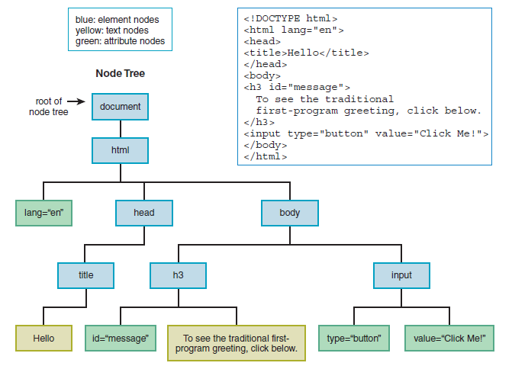
Outline
Document Object Model
The Document Object Model, which is normally referred to as the DOM, models all of the parts of a web page document as nodes in a node tree. A node tree is similar to a directory tree, except instead of showing directories that include other directories (and files), figure 1., shows web page elements that include other elements (and text and attributes).
Each node represents either (1) an element, (2) a text item that appears between an element’s start and end tags, or (3) an attribute within one of the elements.
It shows yellow nodes for each text item that appears between an element’s start and end tags (e.g., “Hello”). And it shows green nodes for each attribute in the web page document’s elements (e.g., h3’s id attribute).
Figure 1. Node tree for simplified Hello web page

Slide 17
Outline
Document Object Model (continue…)
The nodes are arranged in a hierarchical fashion, where nodes at the top contain the nodes below them (e.g., the head node contains the title node). The node at the top of the node tree is the document object.
The term dynamic HTML refers to updating the web page’s content by manipulating the DOM’s nodes.
The DOM provides different ways to access the nodes in the node tree. Here are three common techniques:
1. You can retrieve the node tree’s root by using document (for the document object) in your code and then use the root object as a starting point in traversing down the tree.
2. You can retrieve the node that the user just interacted with (e.g. a button that was clicked) and use that node object as a starting point in traversing up or down the tree.
3. You can retrieve a particular element node by calling the document object’s getElementById method with the element’s id value as an argument.
Forms and How They’re Processed: Client-Side Versus Server-Side
A form is a mechanism for grouping input controls (e.g., buttons, text controls, and checkboxes) within a web page.
Before we dig into the details of how to implement a form with HTML and how to process the input with JavaScript, let’s look at an example web page that uses a form. Figure 2., shows a temperature conversion calculator.

Slide 18
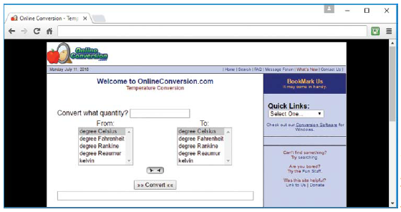
Forms and How They’re Processed: Client-Side Versus Server-Side (continue…)
Outline
Note the quantity text control at the top, the result text control at the bottom, the two list boxes at the sides, and the convert button in the center. All those controls are inside a form.
Behind the scenes, the convert button has a JavaScript event handler. When the user clicks the button and submits the form, the event handler code reads the form’s input values, does the calculation, and displays the result.
There are two basic strategies for processing a form’s input data. The calculations may occur on the client side (on the browser’s computer) or on the server side (on the web server’s computer). With server-side processing, the form input values are transmitted across the Internet to server computer.
Figure 2. Web page that performs temperature conversions

Slide 19
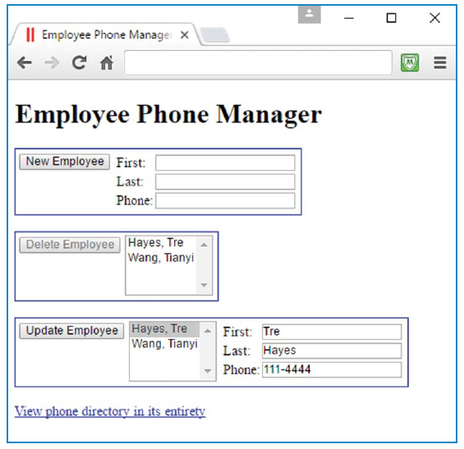
Forms and How They’re Processed: Client-Side Versus Server-Side (continue…)
Outline
The server then does the calculations and transmits the answers back to the client computer. The answers are in the form of a new web page or an updated version of the original web page.
With client-side processing, there’s no need to go back and forth across the Internet with user input and generated results. After the web page downloads, the client computer does all the work.
Therefore, client-side processing tends to be faster. So normally, you should use client-side processing for relatively simple web pages.
The calculations are simple enough that all the programming can be done on the client side, and client-side would lead to a slightly faster experience, so client-side processing is preferred.
Figure 3., shows a web page that manages the phone numbers for employees at a company. Once again, should processing take
Figure 3. Web page that manages the phone numbers for a company’s employees

Slide 20
Forms and How They’re Processed: Client-Side Versus Server-Side (continue…)
Outline
Should processing take place on the client side or the server side? With a large company, there would be a large number of employees, a large amount of data, and a database would be appropriate, so server-side processing is way to go.
With a small company, there wouldn’t be a large amount of data, but, regardless, you need to save the data permanently on the server side, so the updated employee phone data can be viewed later by other users. So with a small company, server-side processing is still the way to go.
form Element
The form element, which is in charge of grouping a form’s controls. Here’s a template for the form element’s syntax:
<form>
label
text-box, list-box, check-box, etc.
label
text-box, list-box, check-box, etc.
...
submit-button
</form>
Note how there’s a submit button control at the bottom and other controls above it. That’s probably the most common layout because it encourages the user to first provide input for the controls at the top before clicking the button at bottom.

Slide 21
form Element (continue…)
Outline
If it’s more appropriate to have our submit button at the top or in the middle, then we should put our submit button at the top or in the middle. One other thing to note in the template is the labels. The labels are text prompts that tell the user what to enter in the subsequent controls. The following code implements a form with two text controls and a submit button:
<form>
First Name:
<input type="text" id="first" size="15"><br>
Last Name:
<input type="text" id="last" size="15"><br><br>
<input type="button" value="Generate Email"
onclick="generateEmail(this.form);">
</form>
Notice how this code matches the template provided earlier. The first two controls are text controls that hold first name and last name user entries.
The bottom control is a button. When the button is clicked, its onclick event handler calls generateEmail function that combines entered first and last names to form an email address.
Although it’s legal to use input elements—like text controls and buttons—without surrounding them with a form element.

Slide 22
form Element (continue…)
Outline
Here are some reasons for doing so:
Forms can lead to faster JavaScript processing of the input elements.
Forms provide support for being able to check user input to make sure it follows a particular format. That’s called input validation.
Forms provide the ability to add a reset button to assign all the form controls to their original values. To implement a reset button, specify reset for type attribute, like this:
<input type="reset" value="Reset">
Controls
Figure 4., shows some of the more popular controls and the elements used to implement them. As you can see, most of the controls use the input element for their implementation. But just to make things difficult, not all controls use the input element. Some important controls use the select and textarea elements.
In the figure, note the controls in the first table that use the input element.

Slide 23
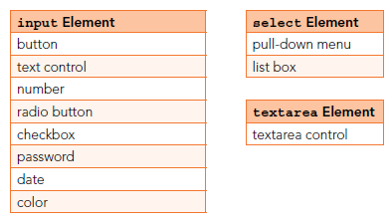
Outline
Controls
Note: number control provides a mechanism for users to enter a number for input, and it has built-in checking to make sure the input is a properly formatted number.
The password control allows the user to enter text into a box where, to help with privacy, the entered characters are obscured. Typically, that means the characters display as bullets. The date control allows the user to enter a month-day-year value for a date. Most browsers implement the date control with a drop-down calendar where the user picks a date from it.
Note: Figure 5., which shows a calendar displayed after the user clicks the down arrow on the date control’s top-right corner. The color control enables the user to select a color from a color picker tool. Figure 5., shows a color picker displayed after the user clicks the color control’s black button.
Figure 4., Some of the more popular controls and the elements used to implement them

Slide 24
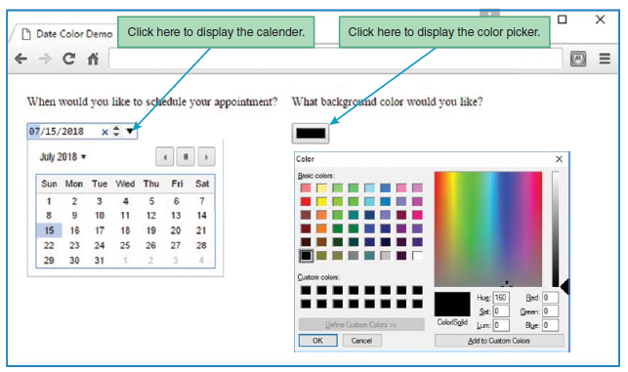
Outline
Controls (continue…)
In Figure 4., note the two controls that use the select element—the pull-down menu and list box controls. The pull-down menu control normally displays just one item at a time from the list and displays the rest of the list only after the user clicks the control’s down arrow. On the other hand, the list box control displays multiple list items simultaneously without requiring the user to click a down arrow. In figure 4., note the control that uses the textarea element—the textarea control. it allows the user to enter text into a multiline box. So it’s the same as the text control except for the height of the box.
Figure 5. Web page that illustrates the date and color controls

Slide 25
Outline
Summary
In this lecture we started with a brief history of the JavaScript language, And quickly moved to an example web page where we used JavaScript to display a message when the user clicks a button.
We clarified the JavaScript button effects were created using images. When the user moves the mouse over the image, the image was switched to the 'active' image. When the user clicks the image, the image was switched to 'clicked' image. This in effect creates the feeling of a button.
Also explained briefly a function in JavaScript that was similar to a procedure—a set of statements that performs a task or calculates a value, but for a procedure to qualify as a function, it should take some input and return an output where there was some obvious relationship between the input and the output.
We explained the JavaScript variable that was simply a name of storage location. There were two types of variables in JavaScript : local variable and global variable.
In this lecture we highlighted the meaning of An identifier which was a sequence of characters in the code that identifies a variable, function, or property. In JavaScript, identifiers are case-sensitive and can contain Unicode letters, $ , _ , and digits (0-9), but may not start with a digit.
Also we clarified the Assignment Statements and Objects, that were sets and/or re-sets the value stored in the storage location(s) denoted by a variable name; in other words, it copies a value into the variable.

Slide 26
Outline
Summary (continue…)
The Document Object Model (DOM) was explained in this lecture which was a programming interface for HTML documents. It represents the page so that programs can change the document structure, style, and content. The DOM was an object-oriented representation of the web page, which can be modified with a scripting language such as JavaScript.
We highlighted also what is the Forms and How They’were Processed: Client-Side Versus Server-Side
Also we highlighted of the HTMLForm Element property elements returns an HTMLForm Controls Collection listing all the form controls contained in the <form> element. The <form> element is a container for different types of input elements, such as: text fields, checkboxes, radio buttons, submit buttons, etc.
We clarified and described the meaning of the control structures within JavaScript, that allow the program flow to change within a unit of code or function. These statements can determine whether or not given statements were executed - and provide the basis for the repeated execution of a block of code.

Slide 27


THANK YOU

